Slide 1
Analysis of Glassdoor Reviews for competitors - Bloomberg

Slide 2
Agenda
Executive Summary
Overall word cloud for Pros and Cons
What people liked (based on 5 star ratings)
What people liked (based on 4 star ratings)
What people liked (based on 3 star ratings)

Slide 3
Executive Summary
Objectives
Scrapping Glassdoor reviews for competitors given by their employees.
Analyzing reviews of competitors
Identify hidden patterns in data about employee engagement.
Key Observations
We scrapped close to 90% of reviews.
Total 5200 reviews were analyzed.

Slide 4
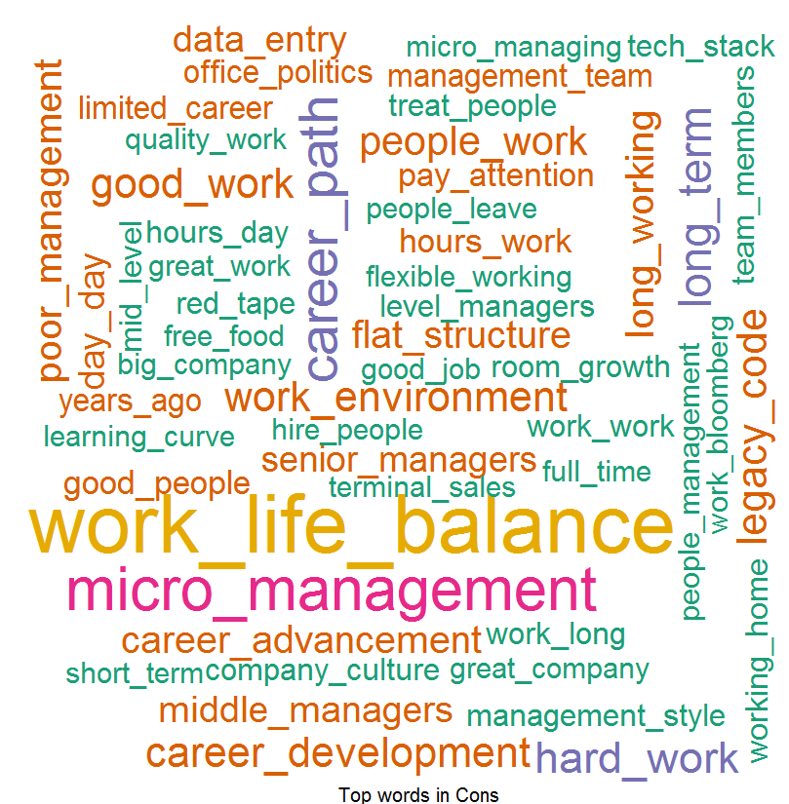
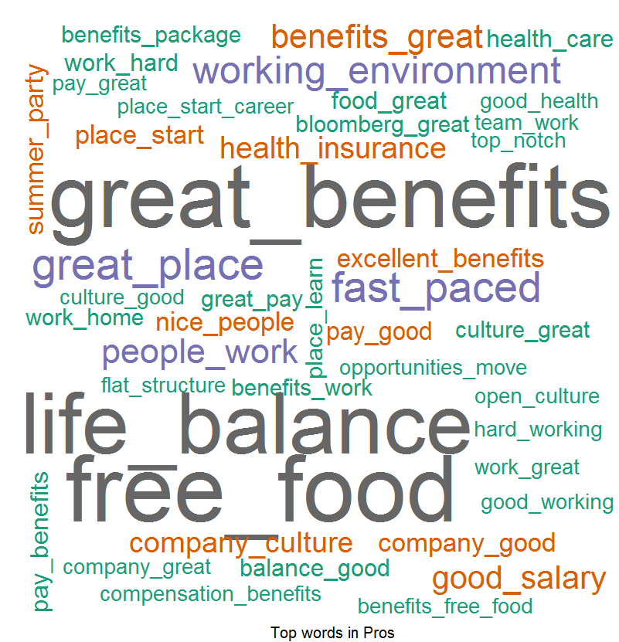
Overall Word Cloud For Pros and Cons
Word Cloud for Pros
Word Cloud for Cons
Good Words List –
Free food
Great Benefits
Work Life Balance
Free snacks
Good Work
Smart people
Word List which people don’t like –
Long hours
Work life balance
Middle management
Team leaders
Working hours
Micro Management
Career Progression

Slide 5
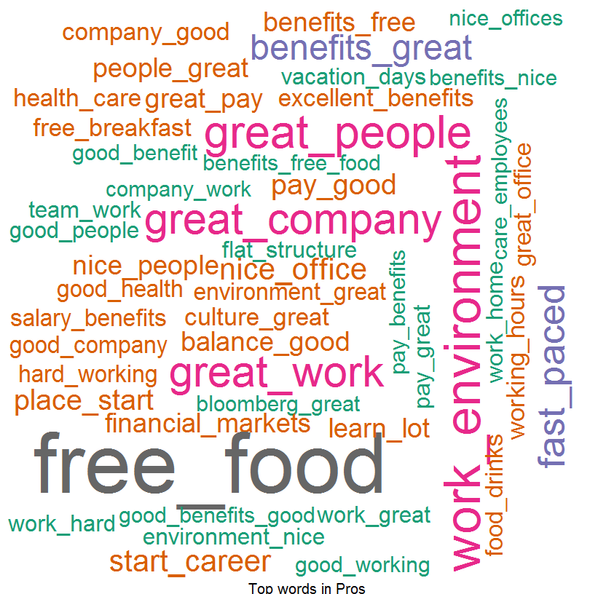
What people liked (based on 5 star ratings)
Word Cloud for Pros
Good Words List –
Work life balance
Great Benefits
Free food
Good work
Work environment
Great people
Great company
Work environment
Good Pay
Health insurance
Training program
Fast paced

Slide 6
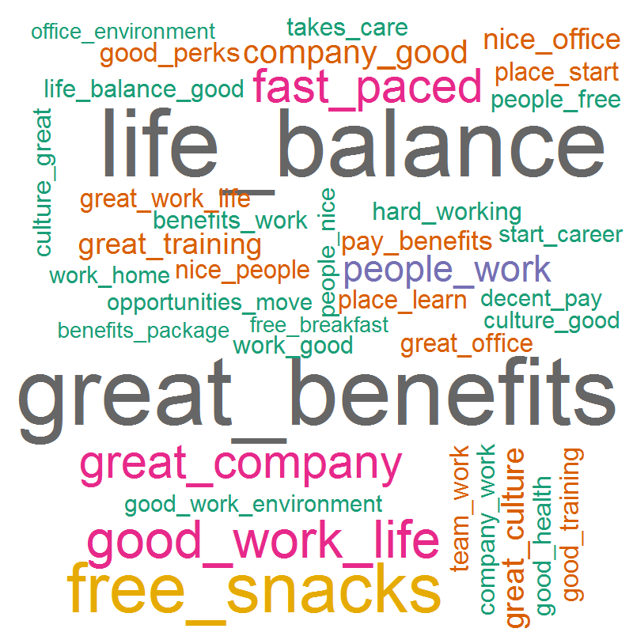
What people liked (based on 4 star ratings)
Word Cloud for Pros
Good Words List –
Great Benefits
Work life
Free food
Good work
Free snacks
Smart people
Fast paced
Work environment
Great company
Great people
Working environment
Good training
Decent pay

Slide 7
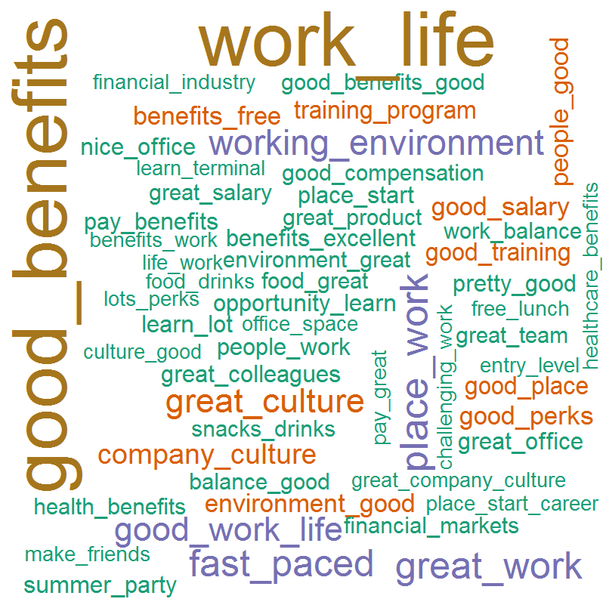
What people liked (based on 3 star ratings)
Word Cloud for Pros
Good Words List –
Free food
Work life
Good benefits
Free snacks
Great place
Good work
Great people
Work environment
Great culture
Good pay
Good perks

